Slide 1
Sacred Trusts
(part 5)

Slide 2
Previously:
Sacred Message: Gospel (1 Thess. 2:4)
Sacred Soldier: Evangelists (2 Tim. 2:1-4)
Sacred Romance: Marriage (Heb. 13:4)
Sacred Rulers: Elders (Titus 1:5-9)
Sacred Measure: Time (Psalm 90:12)

Slide 3
Children
Sacred Heritage
6

Slide 4
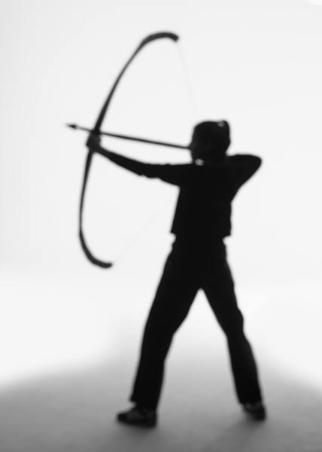
Psalm 127
³ Behold, children are a heritage from the LORD, The fruit of the womb is a reward.
⁴ Like arrows in the hand of a warrior, So are the children of one’s youth.
⁵ Happy is the man who has his quiver full of them; They shall not be ashamed, But shall speak with their enemies in the gate.
Notes:
The Psalm speaks of the dependency and providing hand of God. As in verse 1 He is the one who gives the abilities to build the house; He is the one who gives the gift of protection. So in verse 2, He provides success and sweet sleep to those who trust in Him. They know it is of no value to rise up in anxiety or stay up in anxiety to be burdened with the stress of life. But God gives His own people sweet sleep so that while others are anxious and laden with sorrow, those who trust in God are in repose and calm (cf. this exampled in the extreme with Jesus Mk. 4:38; also see Acts 12:6; Jer. 31:26).
So in verse 3, God gives children as a reward. We get them from Him.
We ought to appreciate once again the high regard of marriage that is held within the scriptures. Marriage is honorable among all (Heb. 13:4). A wife and children are a blessing from God (cf. Ps. 128:3). Celibacy is not given a higher plane than marriage but only in a narrow and very restrictive sense of a present distress (1 Cor. 7:26). The happy man of scripture has a godly wife and a quiver full of children. Perhaps here we see into the heart of God who wants to fill heaven with His own special people, His own children.

Slide 5
If Children Are A Heritage From The Lord
What do they do who abort them?
What do they do who ignore them?
What do they do abandon them?
What do they do who fail to train them up in the Lord?
“But did He not make them one, Having a remnant of the Spirit? And why one? He seeks godly offspring. Therefore take heed to your spirit, And let none deal treacherously with the wife of his youth” (Mal. 2:15)
Notes:
IGNORE: Pr 29:15, “The rod and rebuke give wisdom, But a child left to himself brings shame to his mother.” Eph. 6:1-4.

Slide 6
Proper View of Children
Children are a heritage (Ps. 127:3; Gen. 48:9)
Children are like the arrows in the hand of a warrior (Ps. 127:4)
Children are like olive plants all around your table (Ps. 128:3)
Grandchildren are a crown of old men (Pr. 17:6)
The glory of children is their father
Children model the traits of genuine conversion (Matt. 18:1-5; Mk. 10:14-16; Eph. 5:1)
Balancing thought (1 Cor. 14:20)
Notes:
Ps. 127:4, as a warrior is dependent upon his arrows for his own defense and protection so parents can become reliant and secure upon their children when they are formed as strait arrows.
Ps. 128:3, a picturesque scene of young growing olive plants surround the table and providing the blessings which they provide. Such plants are noted for their beauty in Hosea 14:6, 7. It is almost as if they uphold your table. Sons are described as plants grown up and daughters are pillars sculptured in palace style (Ps. 144:12). They make your house full and complete. They compliment your name. It is no wonder that God stipulated that elders have faithful children in Titus 1:6 for the sheer benefits that they provide, happiness, an alliance of support in contending with enemies (Ps. 127:5) and support and health.
Children model the trait of genuine conversion: humility, dependency, imitation and the absence of malice (also add Eph. 5:1, as dear children). Think of what the doctrine of inherited sin does to these passages? That doctrine takes what is truly God’s display of innocence and corrupts it.

Slide 7
Question
?
If you can see and esteem the worth of children from a biblical perspective, can you also esteem the value of becoming a child of God?

Slide 8
Adopted By God!
An opportunity to become children of God
“For as many as are led by the Spirit of God, these are sons of God. For you did not receive the spirit of bondage again to fear, but you received the Spirit of adoption by whom we cry out, ‘Abba, Father’ ” (Rom. 8:14, 15)
Led by the Spirit by obeying the Spirit’s word
Not to bondage, but to adoption!
“Abba” (From Aramaric)
“Father” (From Greek)

Slide 9
Adopted By God!
An opportunity to become joint heirs with Christ
“The Spirit Himself bears witness with our spirit that we are children of God, and if children, then heirs—heirs of God and joint heirs with Christ, if indeed we suffer with Him, that we may also be glorified together” (Rom. 8:16, 17)
Spirit bears witness through our faithful obedience to the gospel
Result: we are joint heirs with Christ
Must be willing to suffer with Him, be faithful until death (Rev. 2:10)

Slide 10
1 John 3:1-3
1 Behold what manner of love the Father has bestowed on us, that we should be called children of God! Therefore the world does not know us, because it did not know Him.
2 Beloved, now we are children of God; and it has not yet been revealed what we shall be, but we know that when He is revealed, we shall be like Him, for we shall see Him as He is.
3 And everyone who has this hope in Him purifies himself, just as He is pure.
Notes:
What manner of love? This love was manifested toward us, that God was willing for His only Son to come to earth and die for our transgressions so that we can be adopted by Him (see 1 Jn. 4:9, 10).
What do we do to God’s love when we refuse His gift of pardon and His desire to adopt us? It would be as senseless as an orphan who has two people coming into the orphanage and they desperately want to love the child and secure for him a home and yet the orphan refuses to want to go with them and reciprocate that love. If you have a hope of living with God and being like Him and seeing Him as He is, then you would prepare for that! John says he purifies himself! What does that mean?

Slide 11
First Time “Purify” Is Seen In Scripture
“And Jacob said to his household and to all who were with him, ‘Put away the foreign gods that are among you, purify yourselves, and change your garments’” (Gen. 35:2)
Put away foreign gods
Change your garments
Notes:
Point is, it required change.

Slide 12
Acts 15:9
“and made no distinction between us and them, purifying their hearts by faith”
The heart is purified by faith
“Their hearts” were purified by faith
“Their” refers to Cornelius and his household
When were their hearts purified?
When they did what they were told must be done (Acts 10:6)
Obeyed truth in baptism (Acts 10:47, 48; 1 Pet. 1:22)

Slide 13
Galatians 3
HOW TO BECOME SONS OF GOD THROUGH FAITH
HOW TO
26 For you are all sons of God through faith in Christ Jesus.
27 For as many of you as were baptized into Christ have put on Christ.
28 There is neither Jew nor Greek, there is neither slave nor free, there is neither male nor female; for you are all one in Christ Jesus.

Slide 14
1 John 3:10
“In this the children of God and the children of the devil are manifest: Whoever does not practice righteousness is not of God, nor is he who does not love his brother.”
Practice Righteousness and Love Your Brethren!

Slide 15
Review
Children are a sacred trust
given to us by God
Need to appreciate and value children the way God does
God wants us to become His children through obeying the gospel
Need to appreciate the opportunity to become children of God
Need to purify the heart in obeying the gospel and become like little children

